Slide 1
Student Portal
By Jokers

Slide 2
Team Members:
Name | Course
Rishikesh Doorgah | Computer Science
Dishan Gokool Oopadhya | Computer Science
Rahul Mohabir | Management Minor : Business Informatics
Reeshal Rittoo | Computer Science

Slide 3
Web development using Salesforce Community
The website has been created using Salesforce Community Cloud.
Communities are a great way to share information and collaborate with people.
Templates are provided to develop the website.
The Community is connected to the Salesforce Platform which contains several databases called Objects.
Example, the Contact object (database table) is used to store information of all persons registered to the Community.

Slide 4
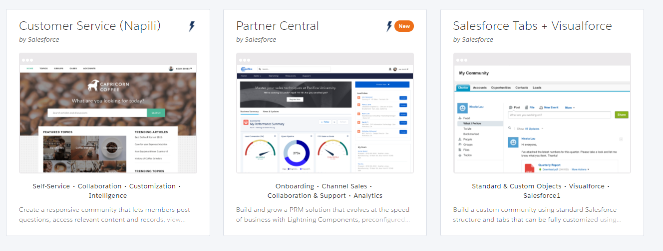
Creating a Community
A unique domain name must be provided before creating the Community.
A template must then be chosen.

Slide 5
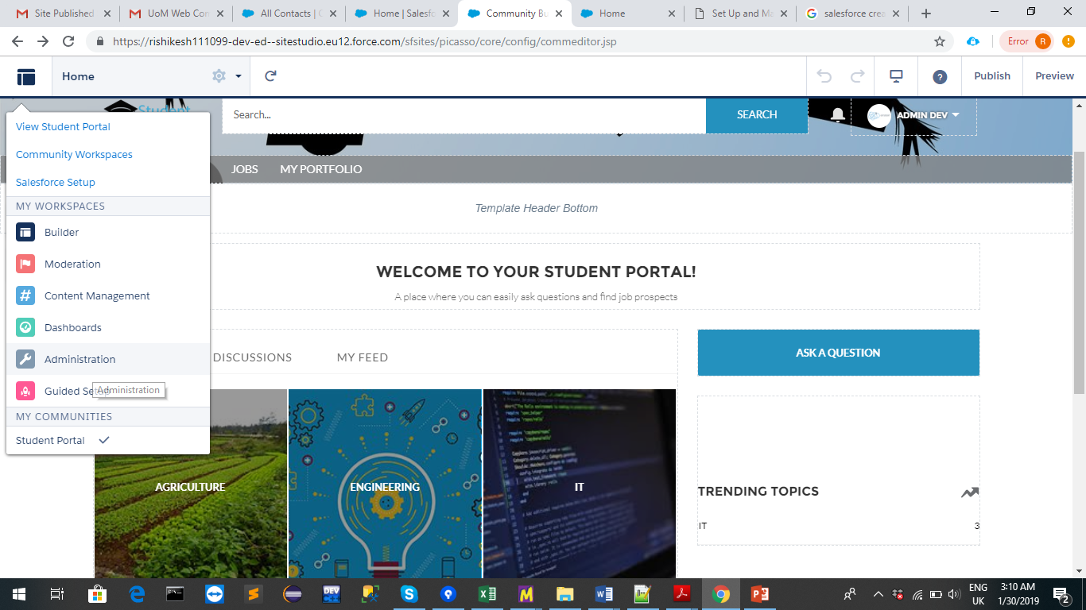
Community Builder
The Community Builder is used to add the different features of the Community.

Slide 6
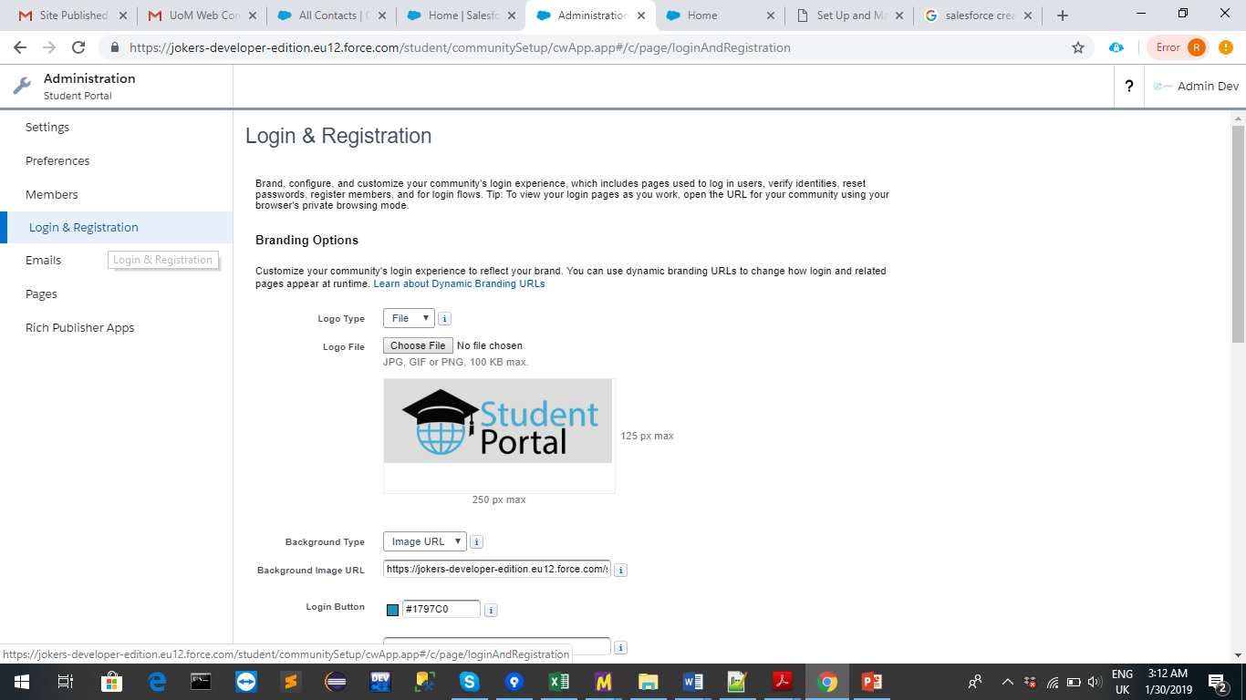
Login & registration configuration
The Administration Workspace is used to configure login & registration

Slide 7
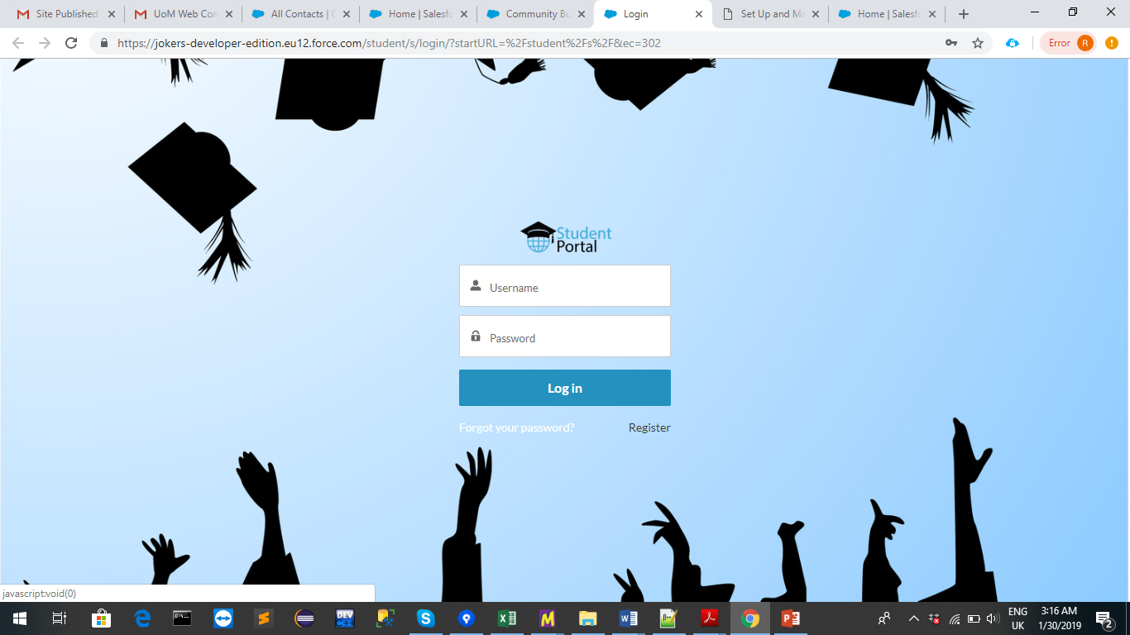
The Login Page

Slide 8
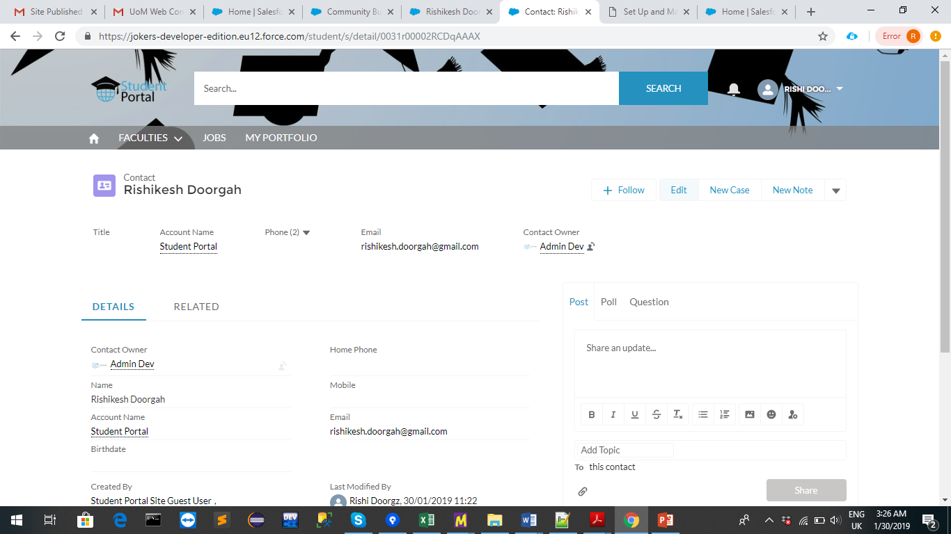
Registration
When a user registers to the Community, a Contact record is created in the Salesforce Database.
Registered User in Community :

Slide 9
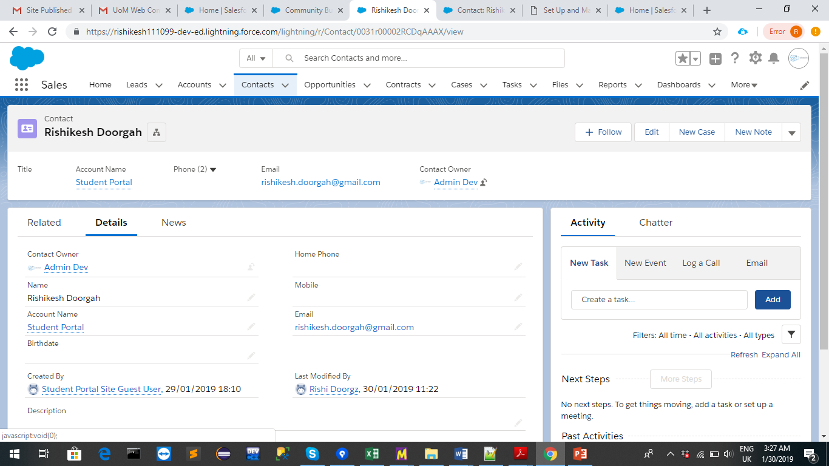
Registered Contact in Database

Slide 10
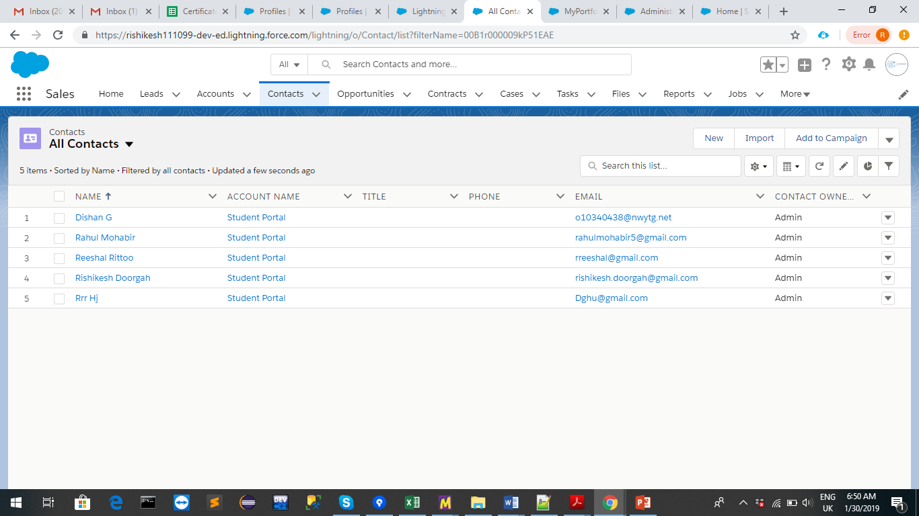
Registered Contacts in Database

Slide 11
User Portfolio
The Details section of the user shows his personal information.
The Contact Object (Database) has 3 child objects namely Education, Work Experiences and Languages.
These 3 objects mentioned above can be accessed on the Related Section of the Portfolio of the User.

Slide 12
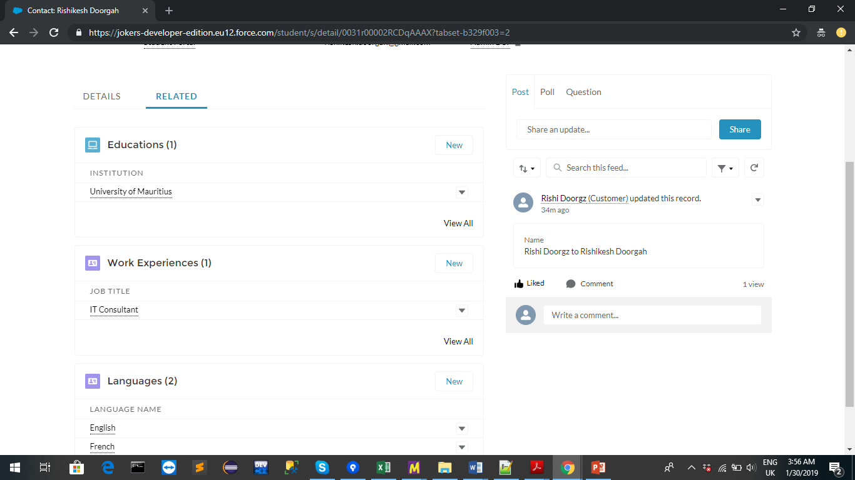
Related Section of User

Slide 13
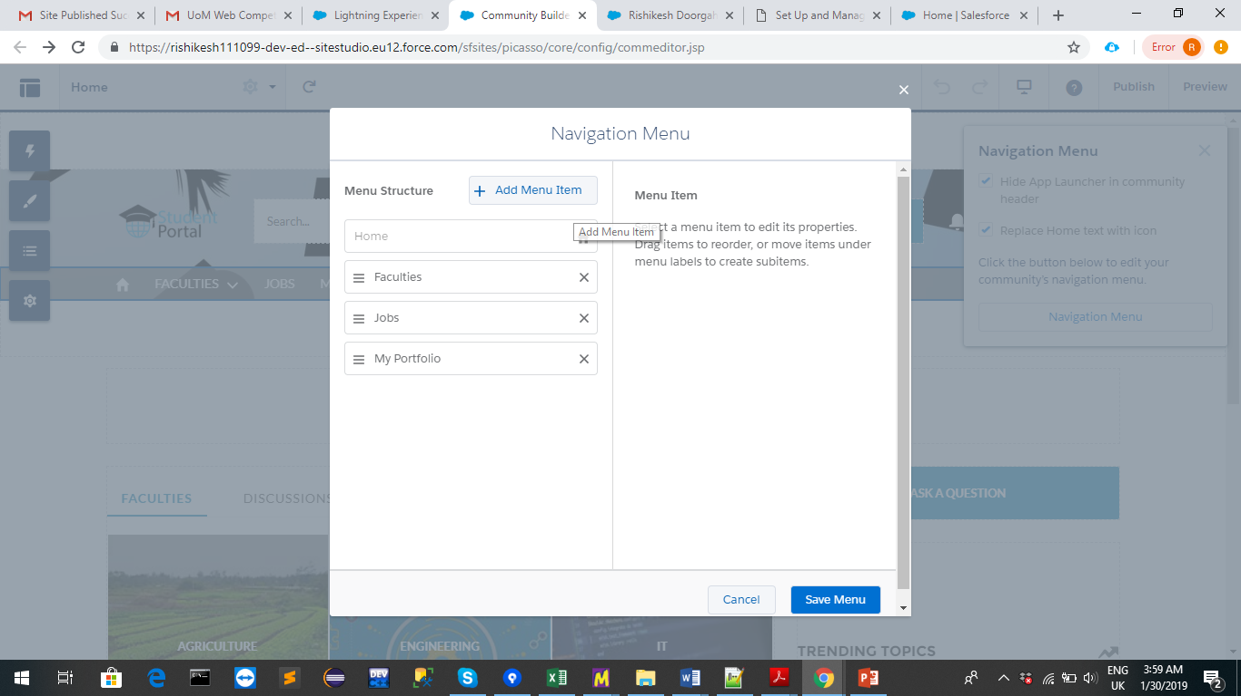
Navigation Menu
The Navigation Menu can be simply customized using the Community Builder.

Slide 14
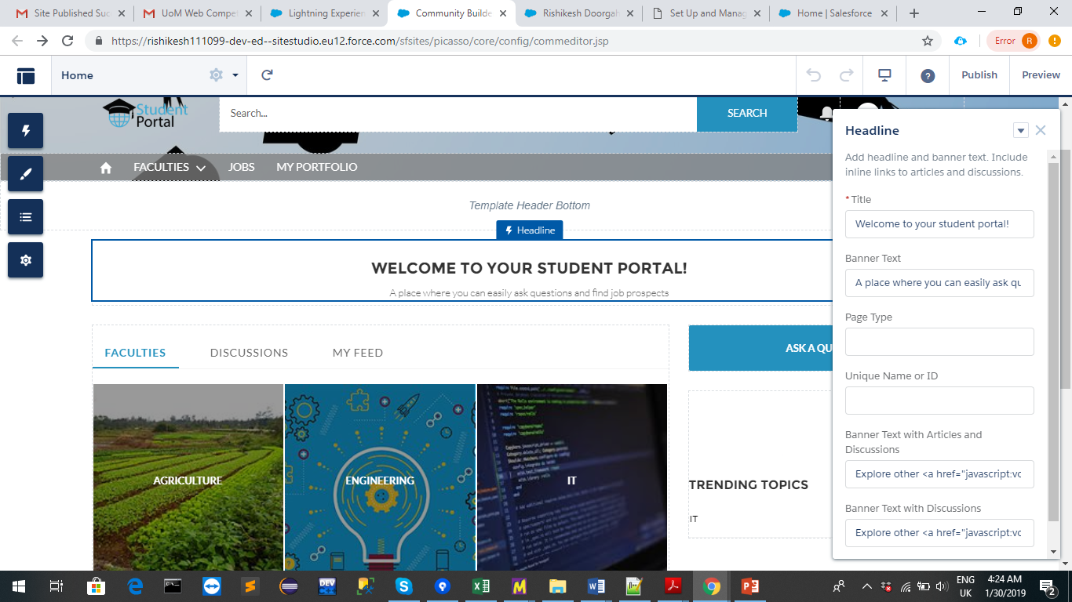
Header of Community
The Headline Component is used to customize the header.

Slide 15
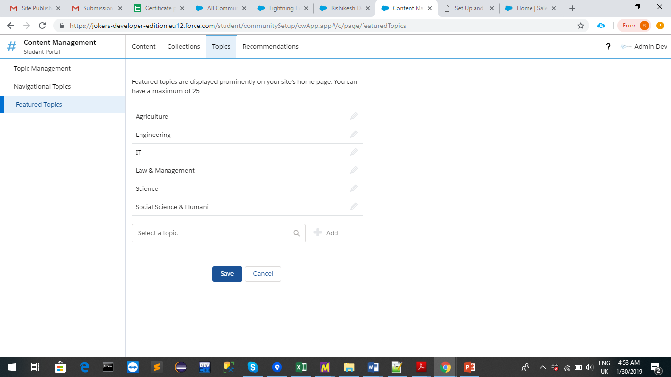
Creating the Faculties
To create the faculties, the topics section of the Content Management Workspace is used.

Slide 16
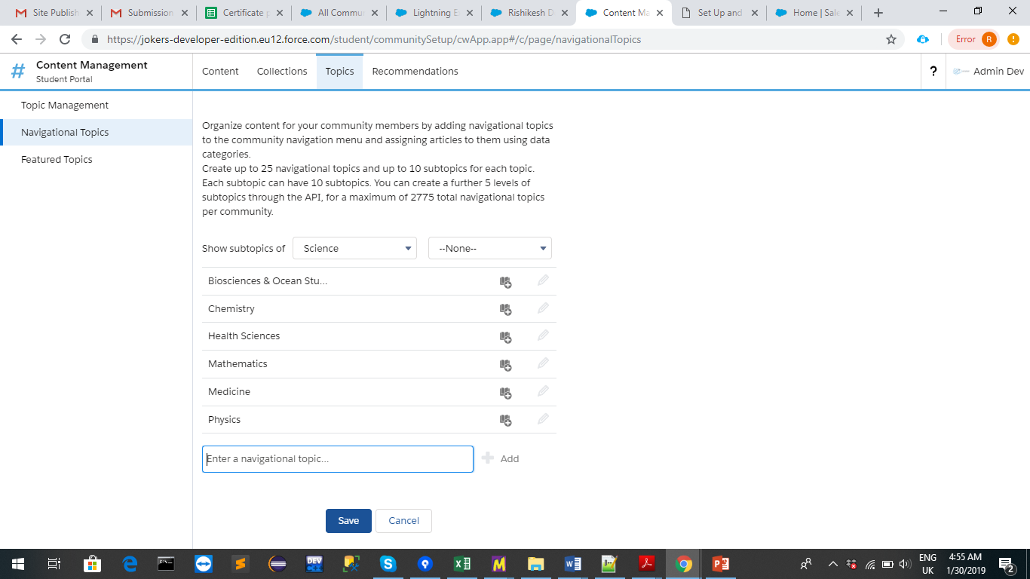
Topics and subtopics
Each topic(Faculty) can have several subtopics.

Slide 17
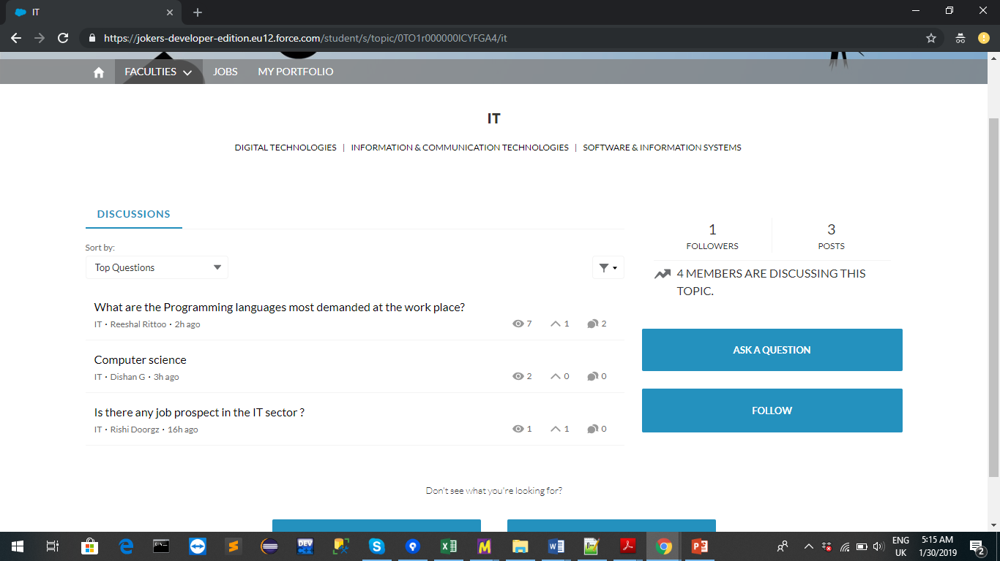
Discussions
A User can post queries in the Discussion section of the Community.

Slide 18
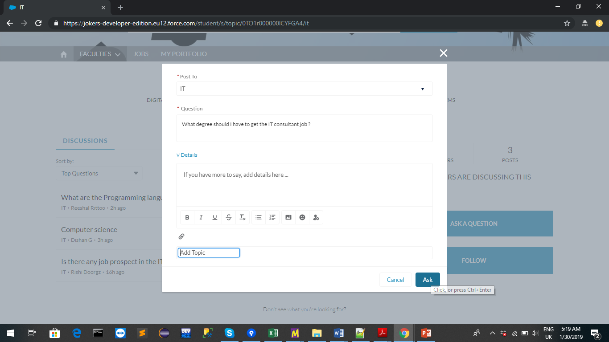
Ask a question
You can post your query using the “Ask a Question” button.

Slide 19
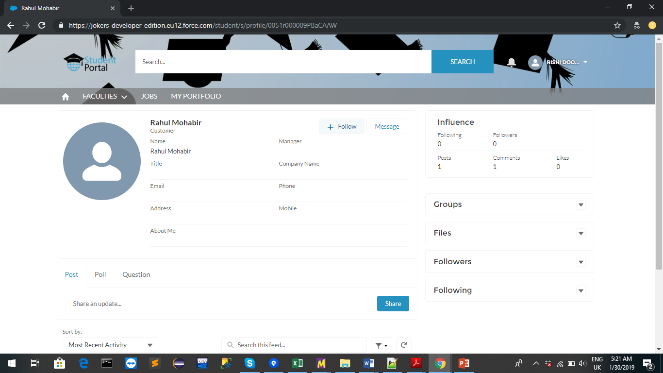
User Information
You can view other user’s information and follow them as well.

Slide 20
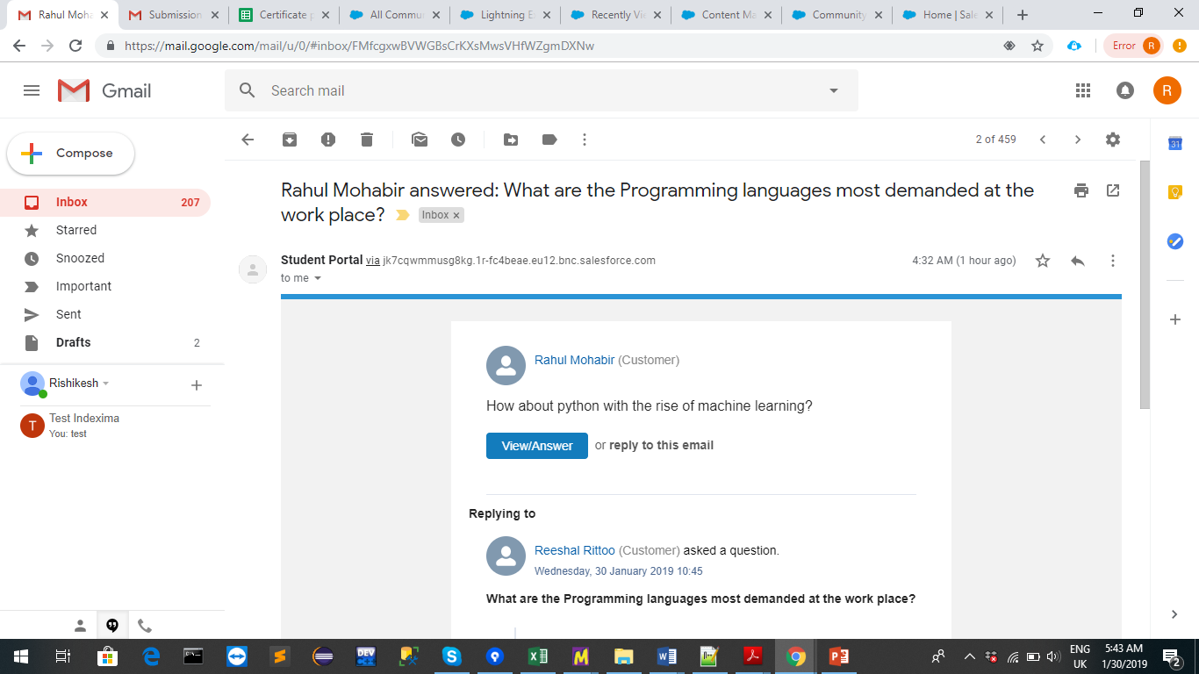
Following user
Following a user means you will get notified when he posts or comments on a post.

Slide 21
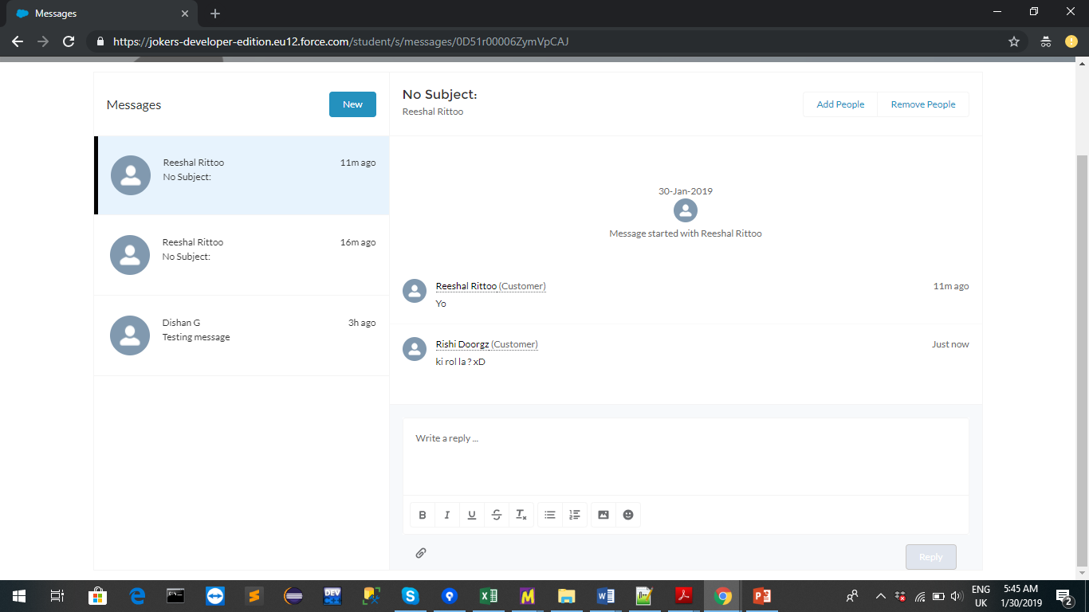
Message
You can also chat with users you followed.

Slide 22
Jobs information
A database called Jobs has been created to store details of the Jobs that were seen on the Community.
However only the admin(s) of the Community can create or edit the Job records.
The normal users can only read Job records.
Each user registered is assigned the “Student Portal” profile which only has the read access to the Job object.

Slide 23
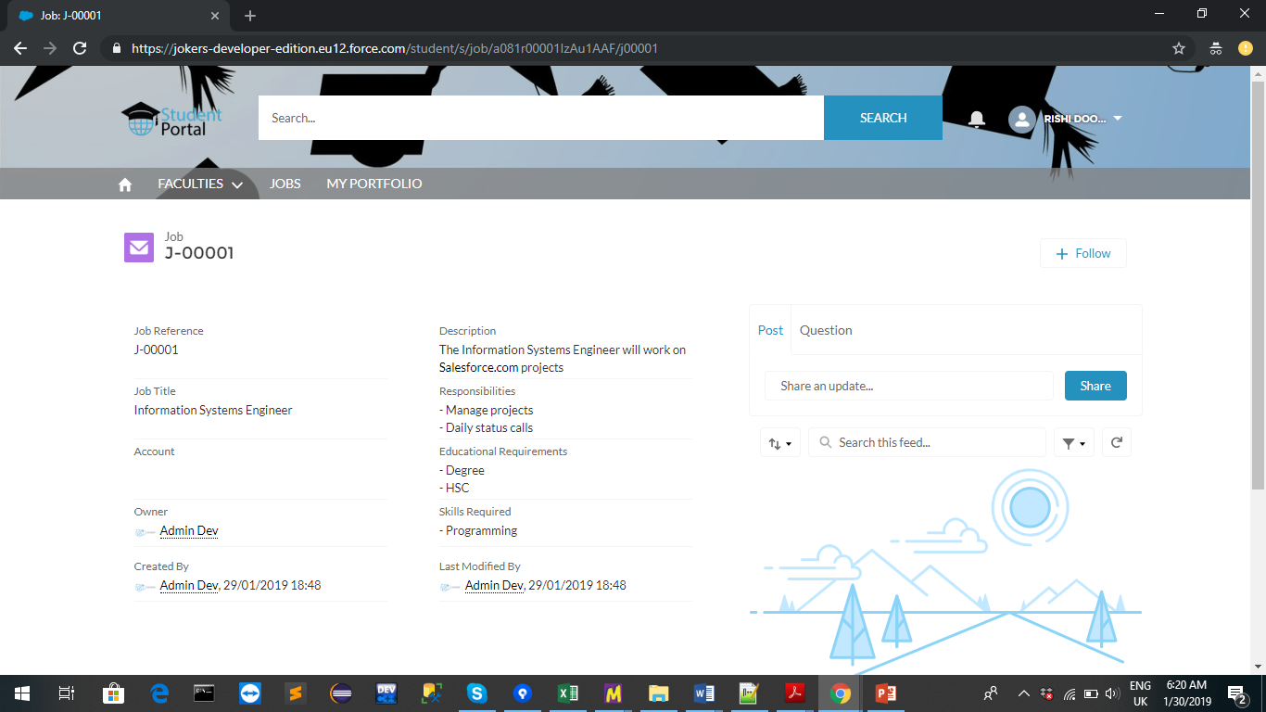
Student Portal User viewing Jobs

Slide 24
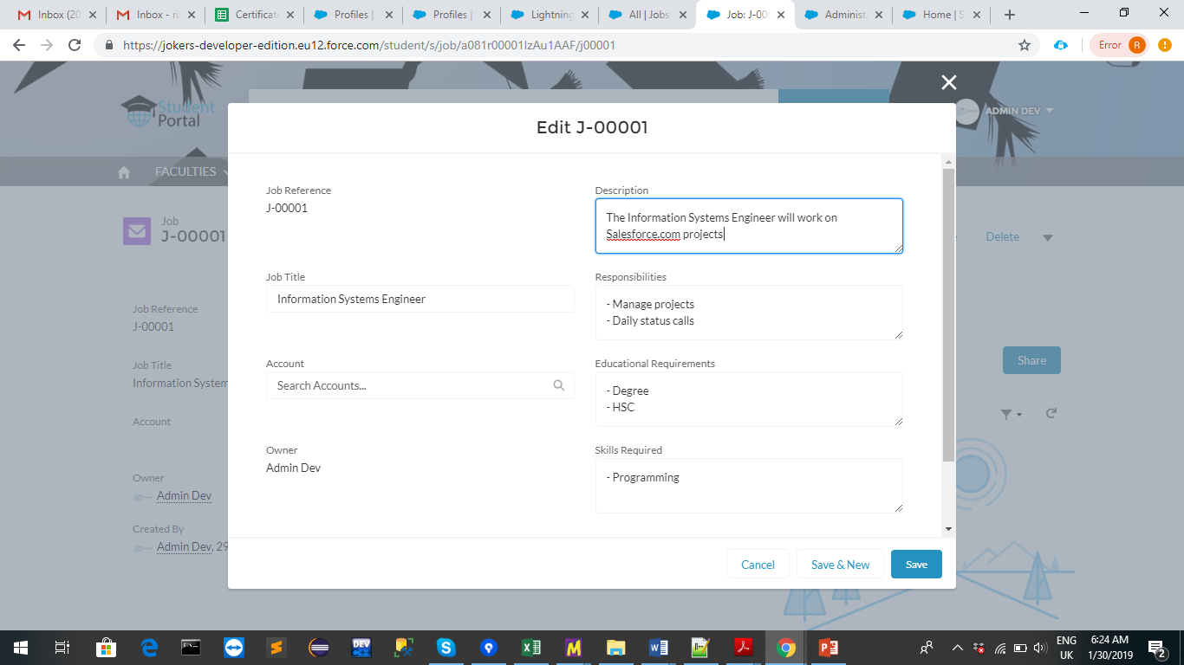
System Admin’s View on Jobs

Slide 25
Designing My Portfolio section
A custom component is added to the My Portfolio section of the Community.
This custom component is created using Lightning Components , a framework for developing web apps for mobile and desktop devices.
Apex is also used for this development. It is an object-oriented programming language that allows developers to execute flow and transaction control statements on the Salesforce Platform Server.
Apex will be used to query the data of the user currently using the Community and the user information will be displayed.

Slide 26
The site can be accessed at the following URL :
https://jokers-developer-edition.eu12.force.com/student/s/login
Salesforce Login :
Username: rishikesh@einstein.com
Password: einstein99
Login URL: https://login.salesforce.com/

